Slide 1
Deforestation web dashboard
Shravya Sama
Tatum Bowen

Slide 2
Goals
Our goal was to do a statistical analysis about a topic we believed to be important and to make this analysis easy to read and navigate. We focused on deforestation of rainforests because it is one of the more obvious environmental problems. A website was used to present the data in a more readable and user-friendly way; it also gave us experience in working with alternative data presentation.

Slide 3
Basic Outline

Slide 4
The Data Analysis
Analyzed the Amazon rainforest (Brazil), the Congo Rainforest (DRC), and the New Guinea Rainforest (Papua New Guinea)
We used three different sets of data for each rainforest; all with the same information
This made data comparison rather simple
Some of the data required cleaning to make it usable for our different analyses
For each rainforest:
Rainforest tree loss
Surrounding region tree loss
Drivers for tree loss
Carbon emissions
Further statistical analysis

Slide 5
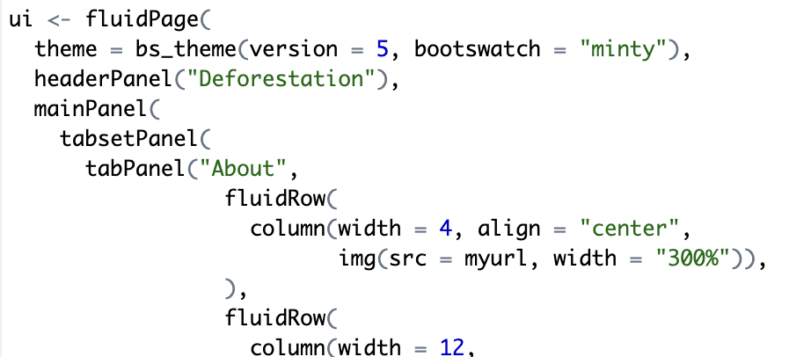
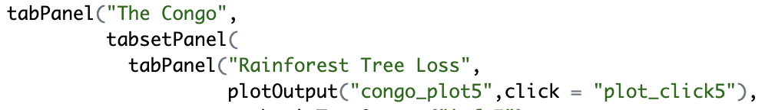
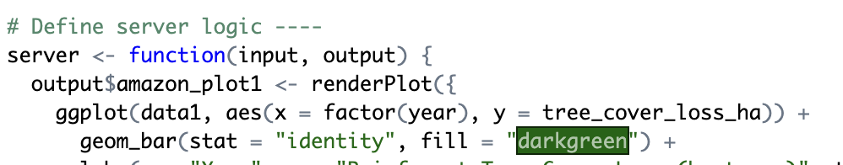
The Website
We explored using multiple website formats and packages, but chose to use the shiny package in R.
This package allows the use of .png, ggplot2, and, although it requires knowledge of the functions in the package – which are very different from other R functions – it still makes using R code and RMarkdown files possible. It took a basic understanding of some Java concepts, but many other formats required extensive Java or HTML experience.
The web dashboard is an app.R that is presented as a website using the Posit Cloud. It requires ui, which is used to format the different elements of the website along with the text elements, and a server, which is where the code for the plots and graphs went.

Slide 6
RESULTS SUMMARY

Slide 7
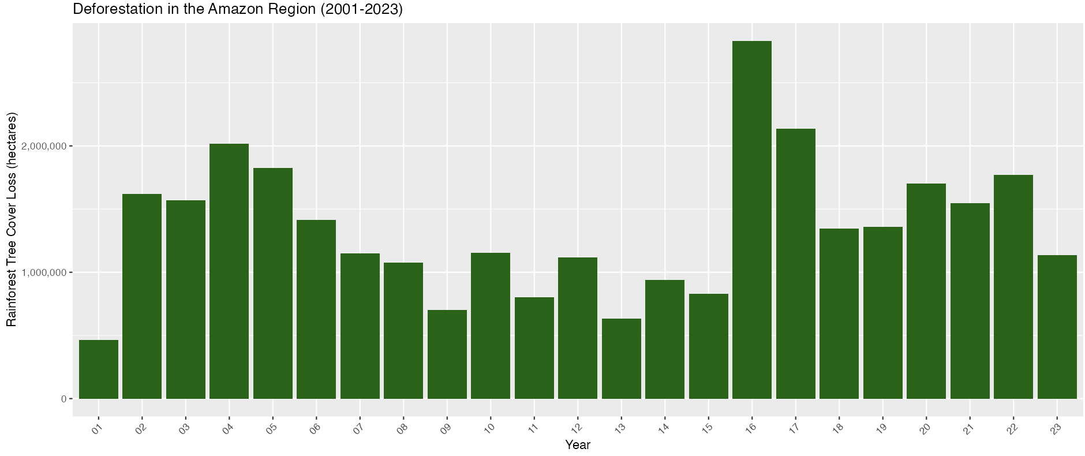
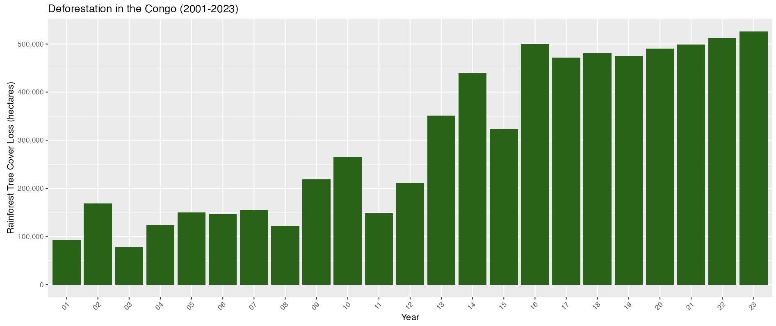
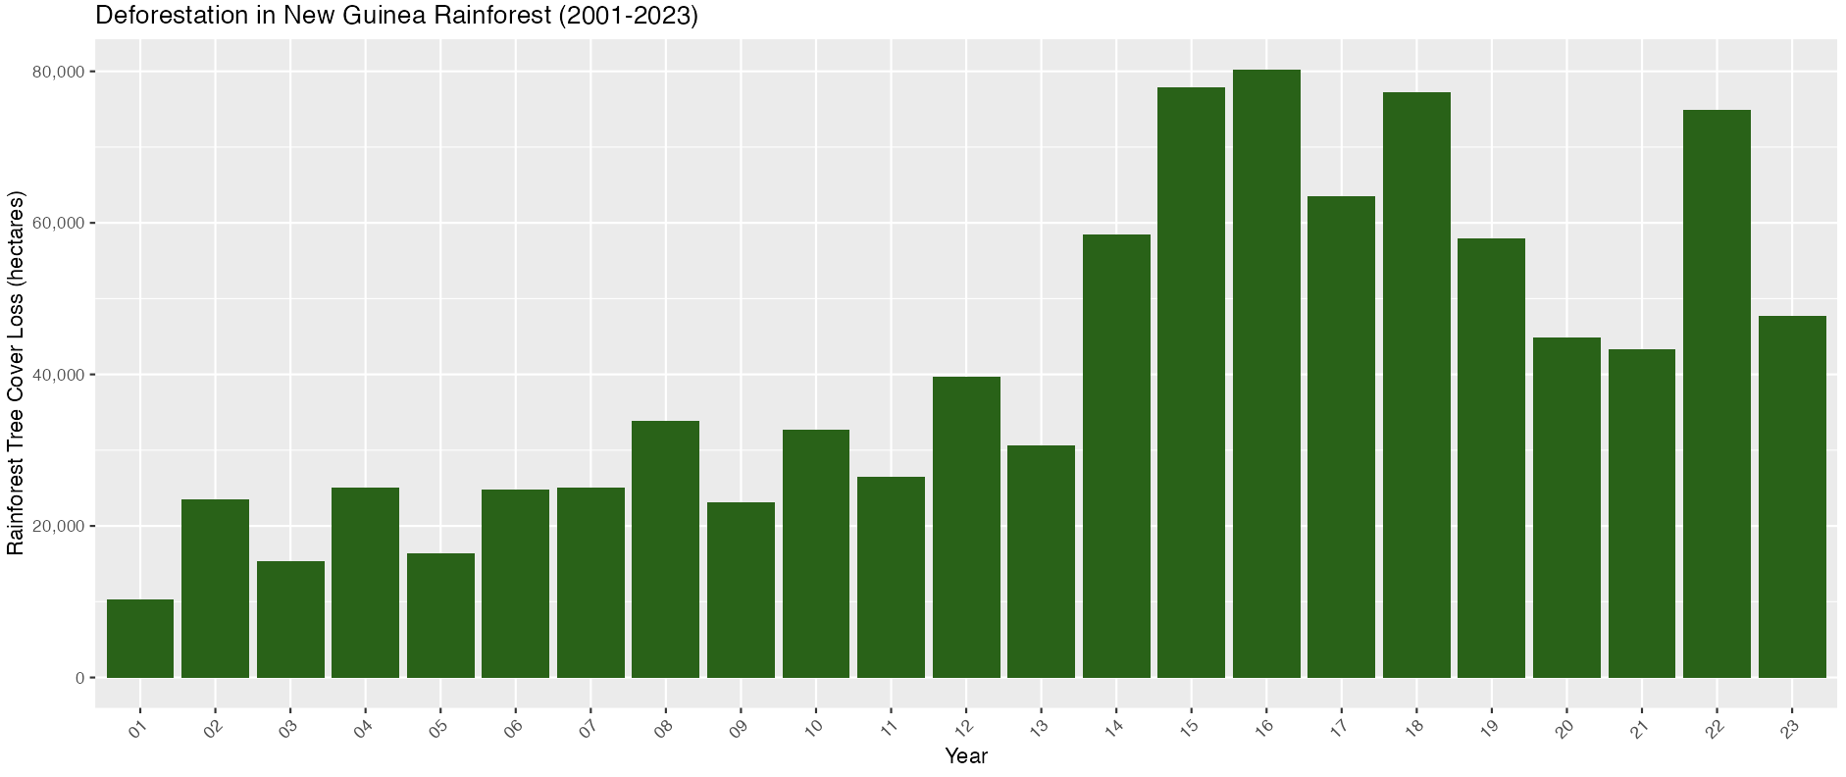
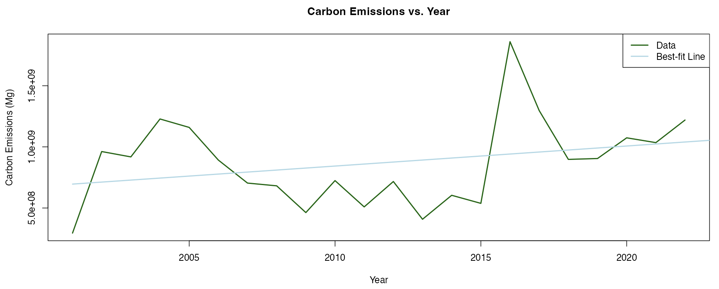
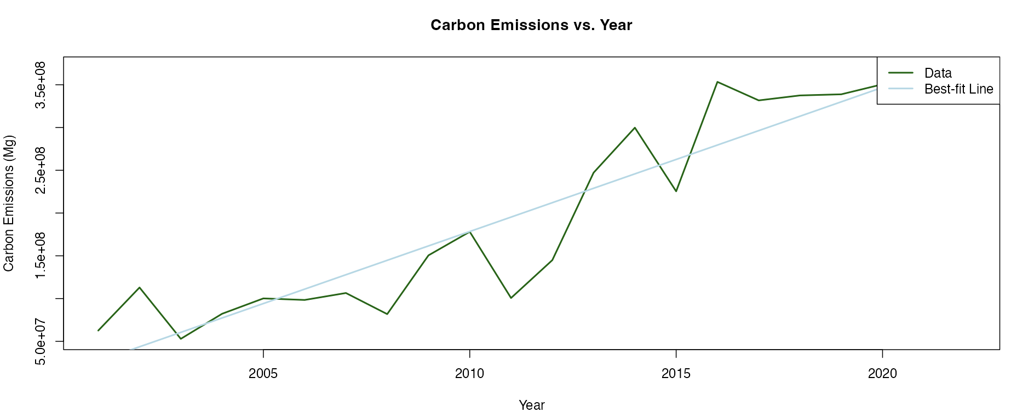
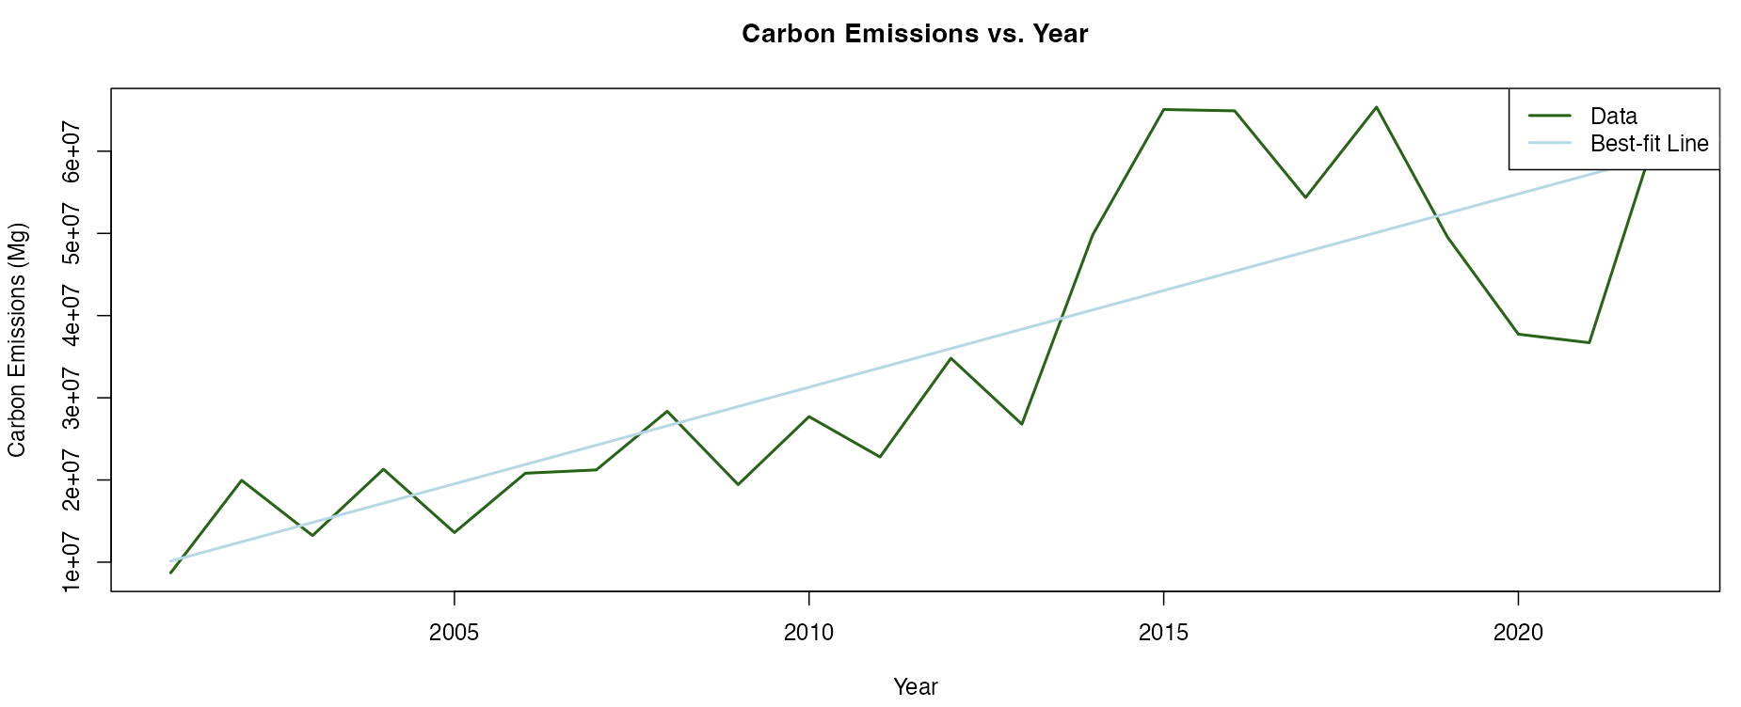
A Quick Comparison
Amazon
Congo
New Guinea

Slide 8
Some stats
Null Hypothesis (H0): There is no significant difference in mean emissions between primary and driver tree cover loss.
Alternative Hypothesis (Ha): There is a significant difference in mean emissions between primary and driver tree cover loss.
Brazil
p-value: 6.1791519^{-7}
Papua New Guinea
p-value: 0.0037836
Congo
p-value: 0.0013022
Brazil- 95% Confidence Interval: (3.8046823^{8}, 7.4019261^{8})
Primary tree cover loss emits more greenhouse gases than driver tree cover loss on average.
Papua New Guinea- 95% Confidence Interval: (-4.1727869^{7}, -8.7096746^{6})
Driver tree cover loss emits more greenhouse gases than primary tree cover loss on average.
Congo- 95% Confidence Interval: (4.4529888^{7}, 1.7275641^{8})
Primary tree cover loss emits more greenhouse gases than driver tree cover loss on average.

Slide 9
FUTURE EXPANSION

Slide 10
Ways we could expand this project in the future:
Create a more comprehensive website to include more than the three rainforests including.
Add spatial data using GIS or other tools to create interactive maps on the user face; though this would require extensive data accumulation as it is not readily available in a single dataset.
Experiment with other website formats and HTML code to make it more aesthetic.
Include more elements and make the plots and graphs interactive; could use slide bars to show different scales for the x- and y-axes.

Slide 11

References
https://shiny.posit.co/r/articles/build/layout-guide/
https://stackoverflow.com/questions/12888120/loading-png-files-directly-from-url/12888177#12888177
https://rstudio.github.io/bslib/articles/bs5-variables/index.html
https://www.globalforestwatch.org/dashboards/country/COD/
https://www.globalforestwatch.org/dashboards/country/BRA/?map=eyJjYW5Cb3VuZCI6dHJ1ZX0%3D
https://www.globalforestwatch.org/dashboards/country/PNG/?location=WyJjb3VudHJ5IiwiUE5HIl0%3D&map=eyJjYW5Cb3VuZCI6dHJ1ZX0%3D
https://www.youtube.com/watch?v=XoCgToAuzsU
https://i.kisscc0.com/20180517/kpw/kisscc0-amazon-rainforest-forest-floor-tropical-rainforest-nature-5afd5c4a3b22a8.2777891415265536742422.jpghttps://i.kisscc0.com/20180517/kpw/kisscc0-amazon-rainforest-forest-floor-tropical-rainforest-nature-5afd5c4a3b22a8.2777891415265536742422.jpg

Slide 12
link
Website: https://posit.cloud/content/8065091

Slide 13
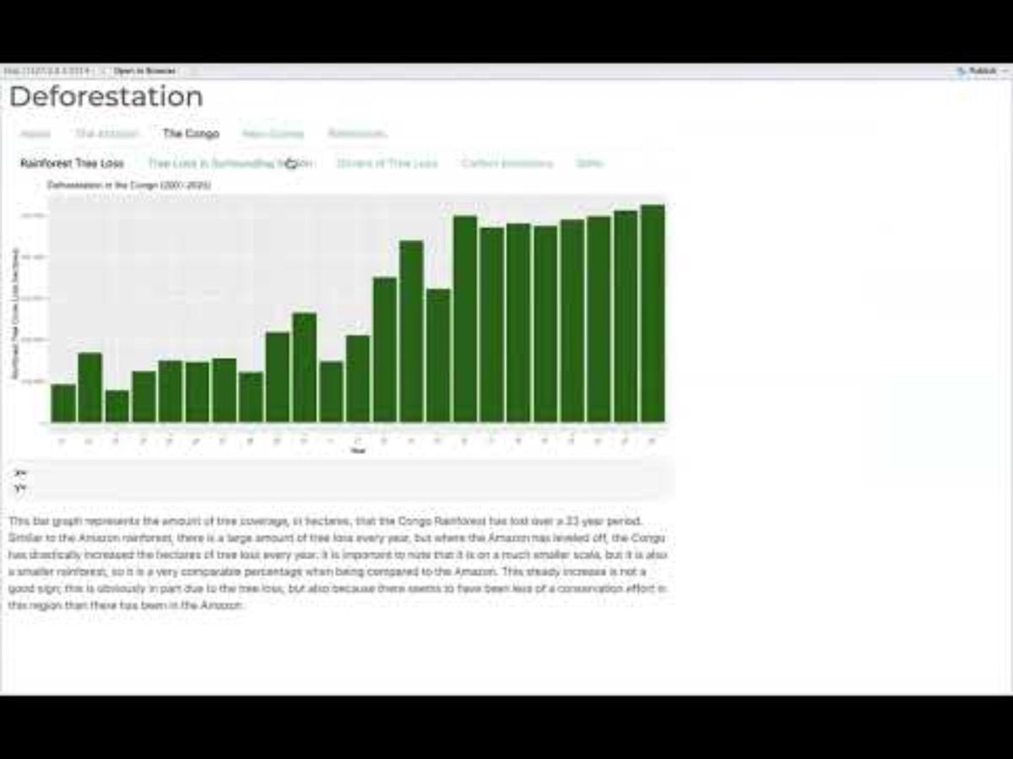
Video
https://youtu.be/OqTuBH0XYKQ

